Slide 1
Introduction to Information-based Learning
National Chung Hsing University
Department of Computer Science and Engineering
NLP Lab
Yao-Chung Fan
yfan@nchu.edu.tw

Slide 2
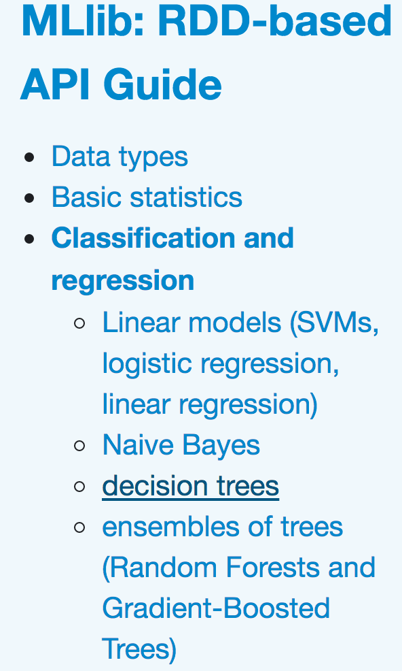
Information-based Learning
To build predictive models using only the most informative features.
An informative feature is a descriptive feature whose values split the instances in the dataset into homogeneous sets with respect to the target feature value.
• Information-based Learning
• Similarity-based Learning
• Error-based Learning
• Probability-based Learning

Slide 3

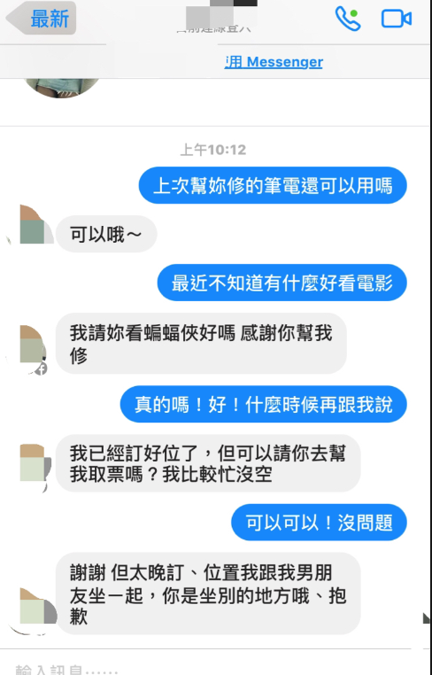

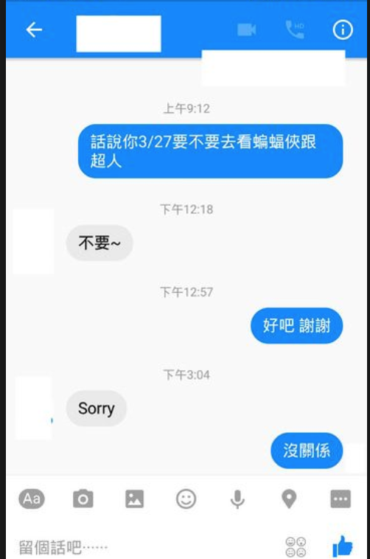
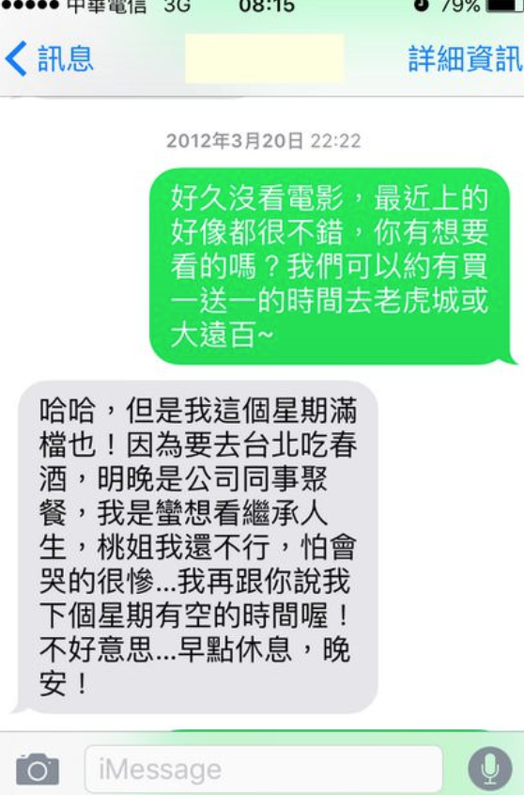
Basic Idea : Learning Rules from Data

Slide 4
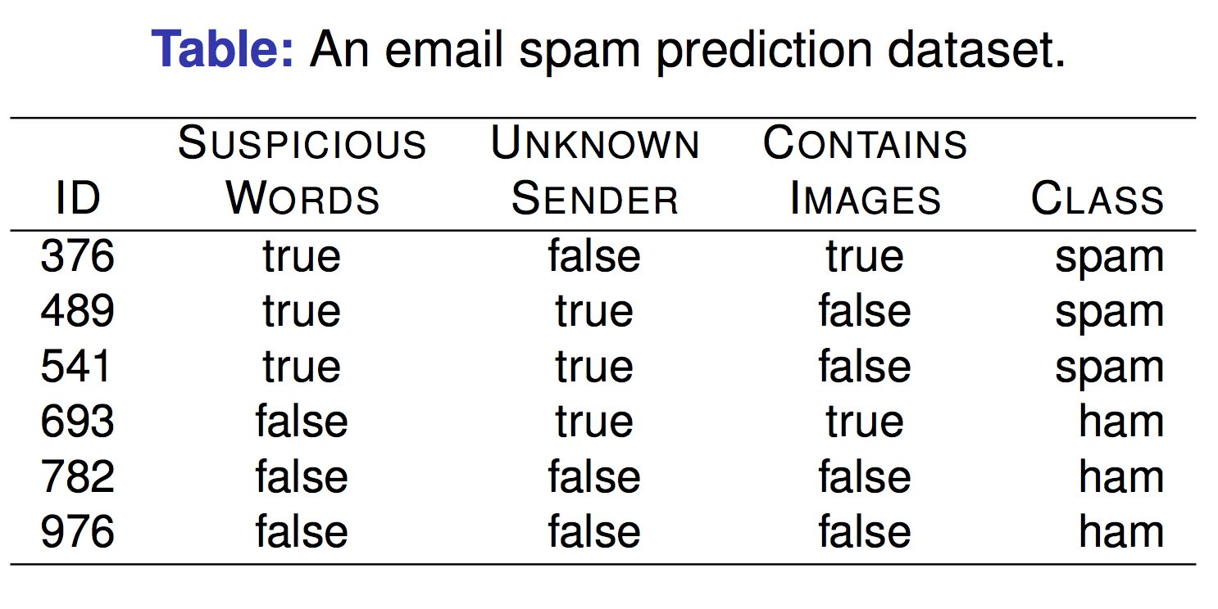
Let’s Look into the following example…

Slide 5
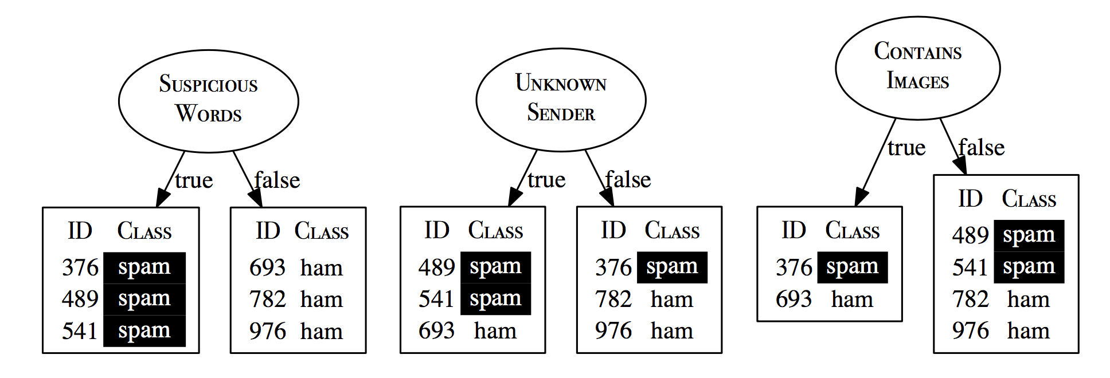
Important features that split the dataset into pure sets with respect to the target class.
All we need to do that is a computational metric of the purity of a set: entropy

Slide 6
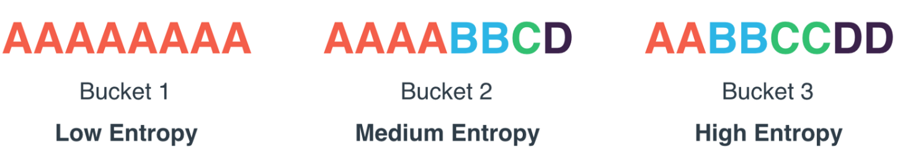
Entropy/Information
Shannon’s entropy model defines a computational measure of the impurity of the elements of a set.
An easy way to understand the entropy of a set is to think in terms of the uncertainty associated with guessing the result if you were to make a random selection from the set.
Entropy is related to the probability of an outcome.
High probability → Low entropy Low probability → High entropy

Slide 7
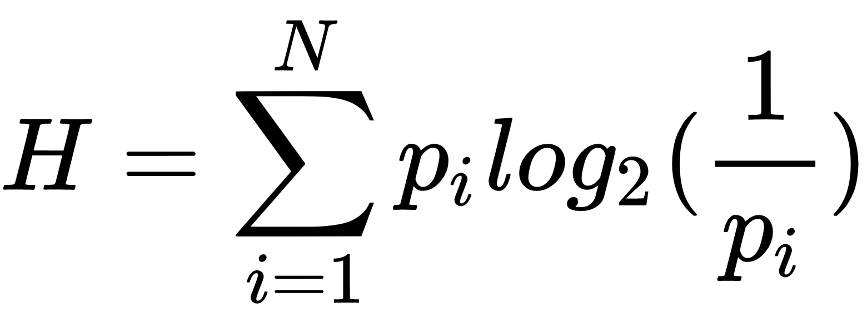
Given a bag, we can compute its entropy by

Slide 8
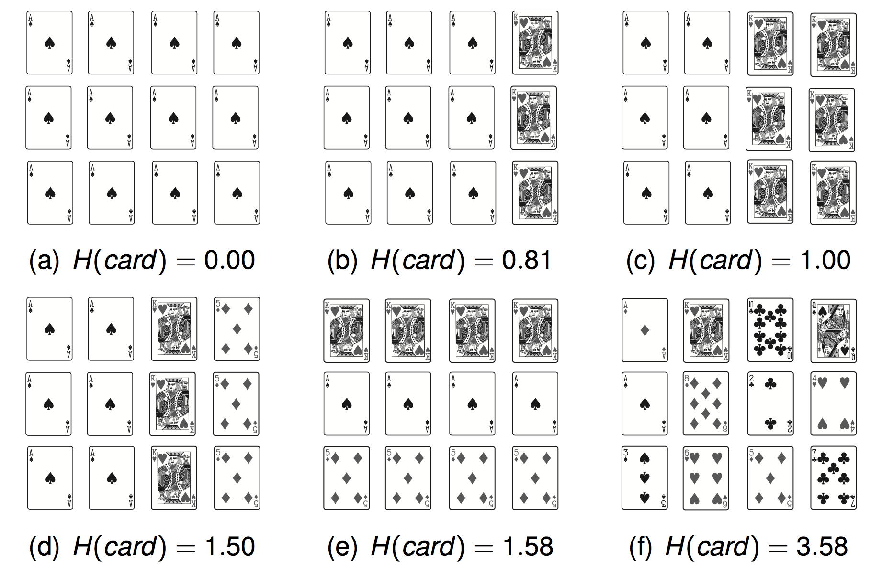
Entropy is related to the probability of a outcome.
High probability → Low entropy Low probability → High entropy

Slide 9
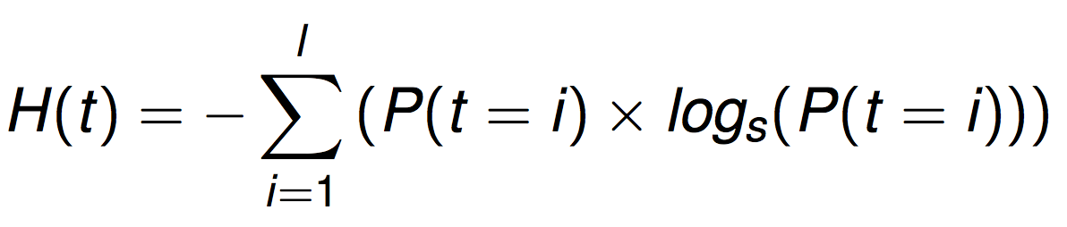
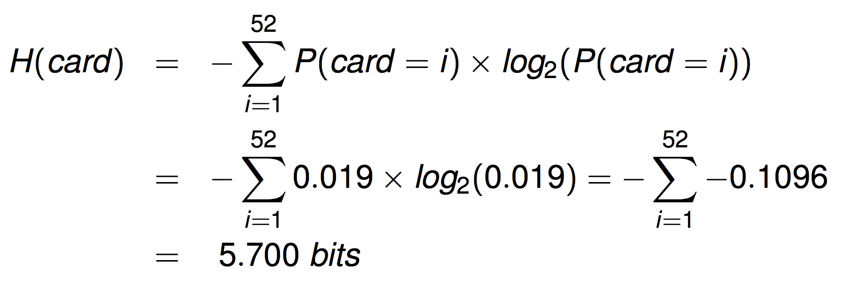
Shannon’s model of entropy is a weighted sum of the logs of the probabilities of each of the possible outcomes when we make a random selection from a set.

Slide 10
Entropy of class outcomes in this example ?

Slide 11
Intuition
Our intuition is that the ideal feature will partition the data into pure subsets where all the instances in each subset have the same classification.
SUSPICIOUS WORDS perfect split.
UNKNOWN SENDER mixture but some information (when ’true’ most instances are ’spam’).
CONTAINS IMAGES no information.
One way to implement this idea is to use a metric called information gain.

Slide 12
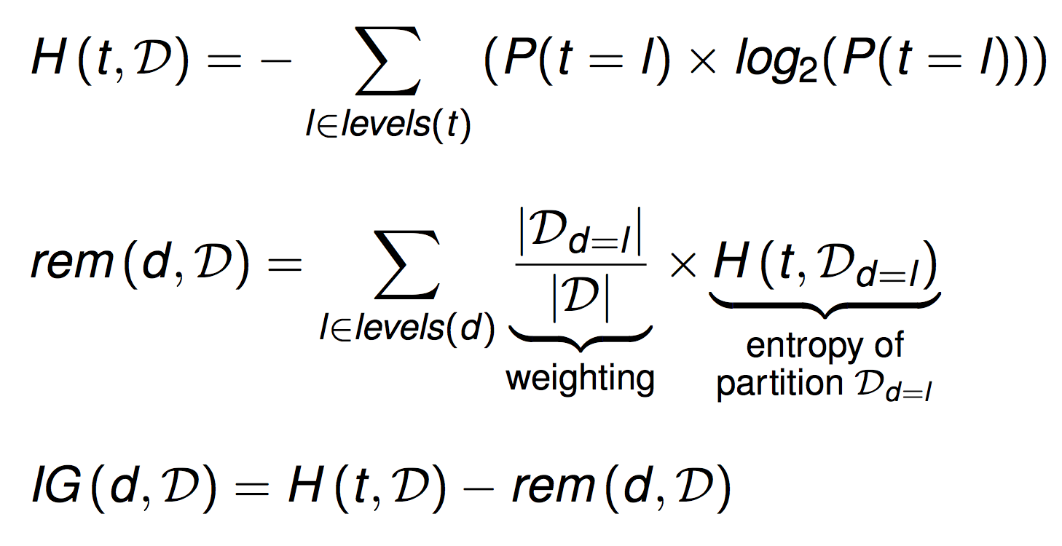
The information gain of a feature can be understood as a measure of the reduction in the overall entropy of a prediction task by testing on that feature.
Computing information gain involves the following 3 equations

Slide 13
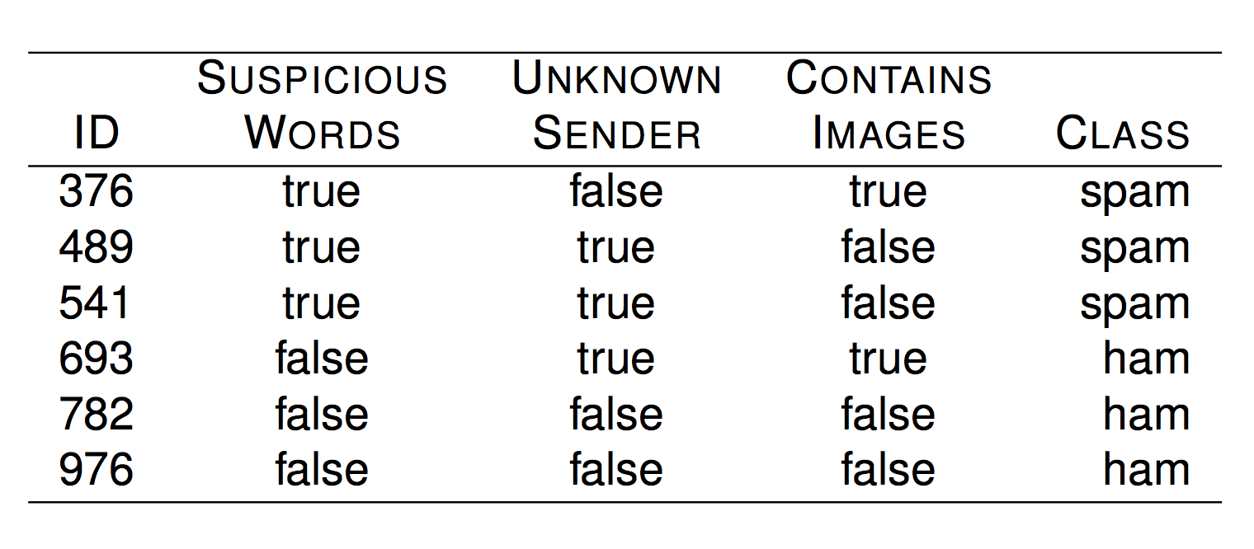
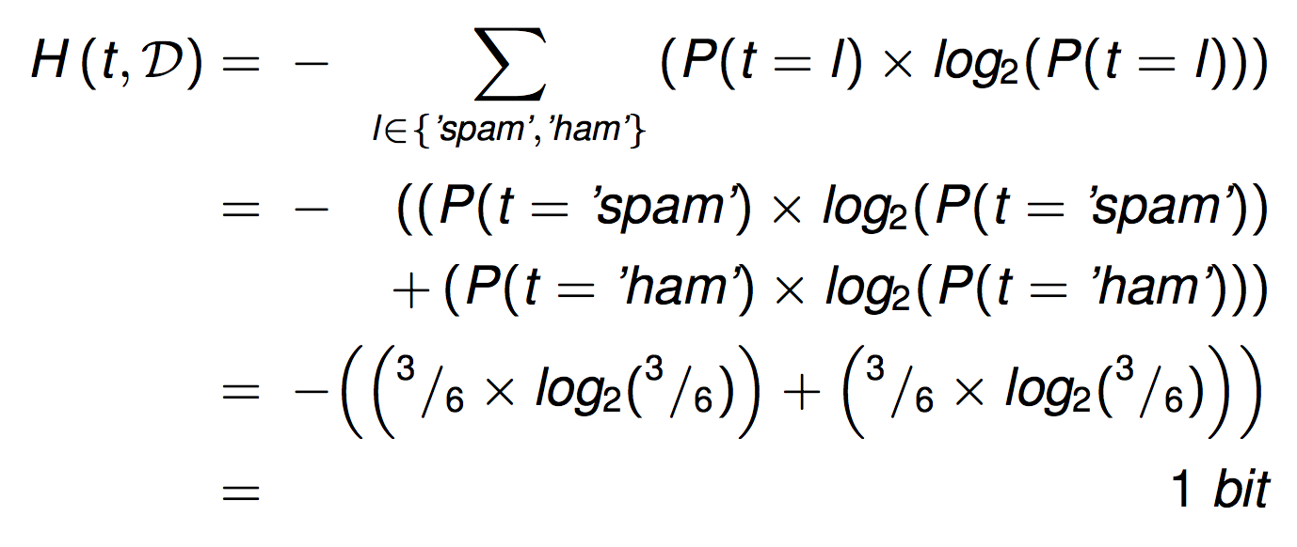
Compute Entropy for Original Data Set

Slide 14
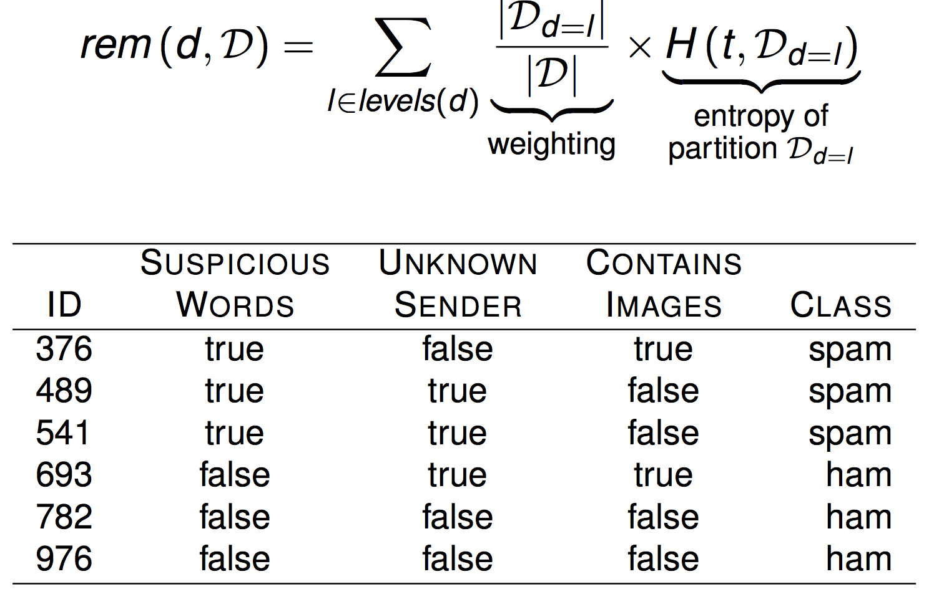
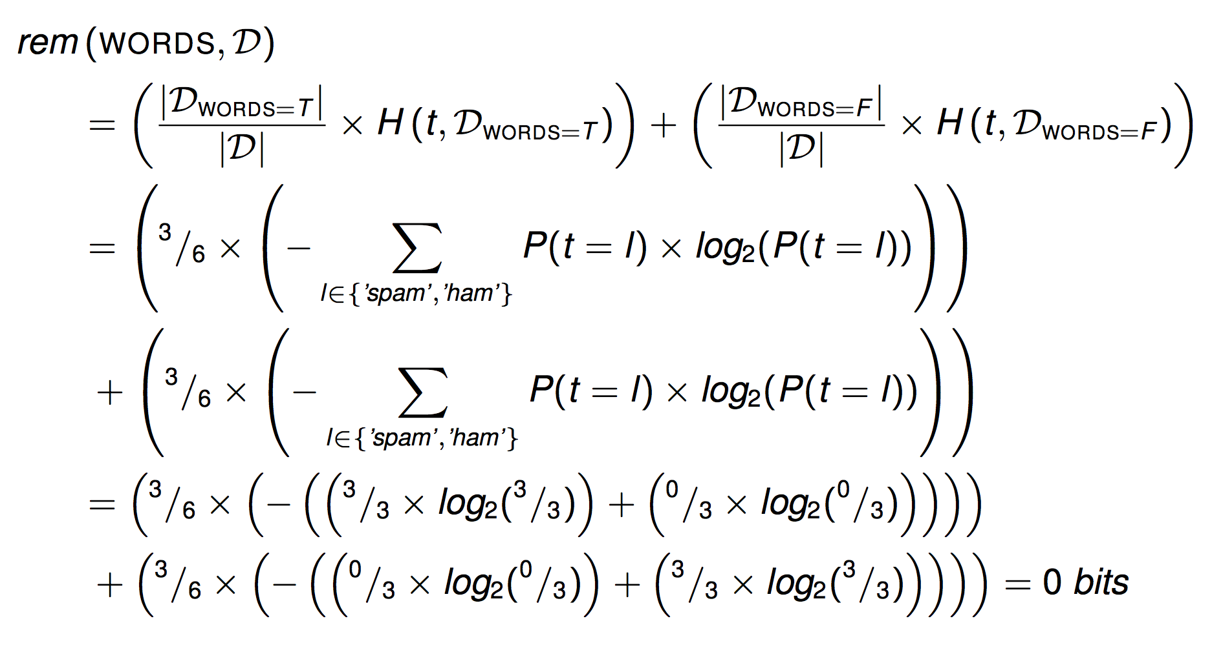
Compute Remaining Entropy after Partitioning

Slide 15
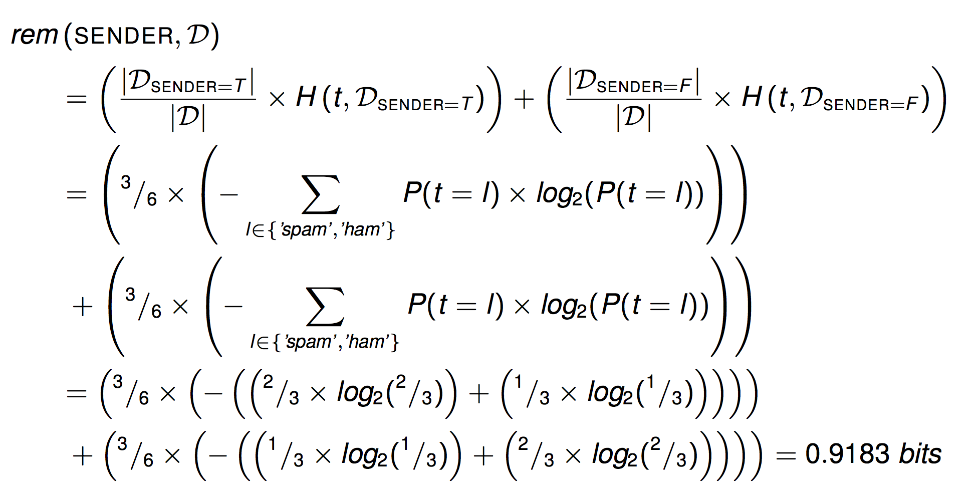
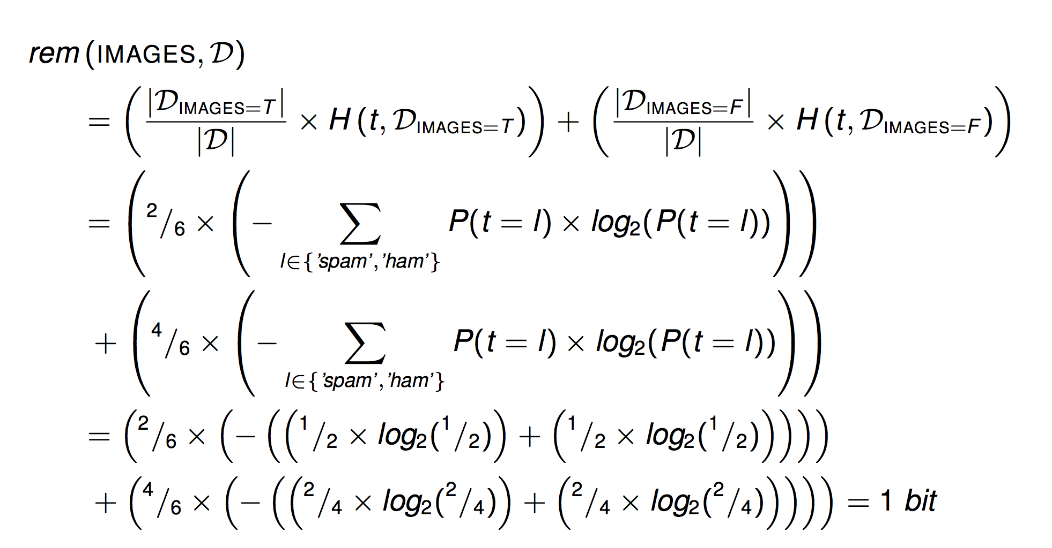

Slide 16
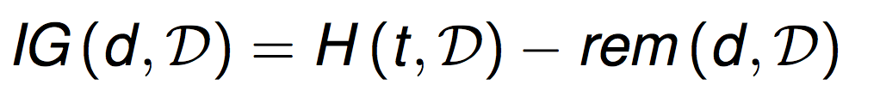
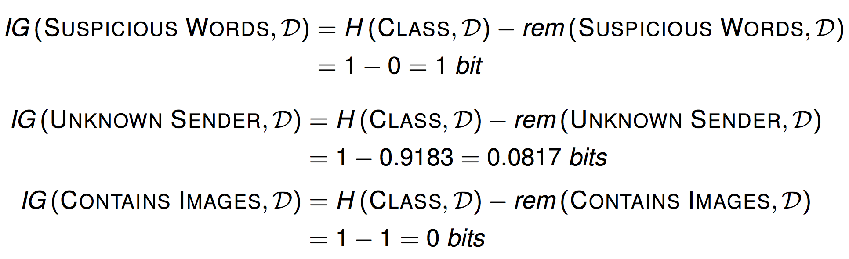
Calculate the information gain for the three descriptive feature in the dataset.

Slide 17
Outline
Basic Idea
Entropy, Information Gain
Decision Tree Overview
Recursively apply the basic idea on a large data set

Slide 18
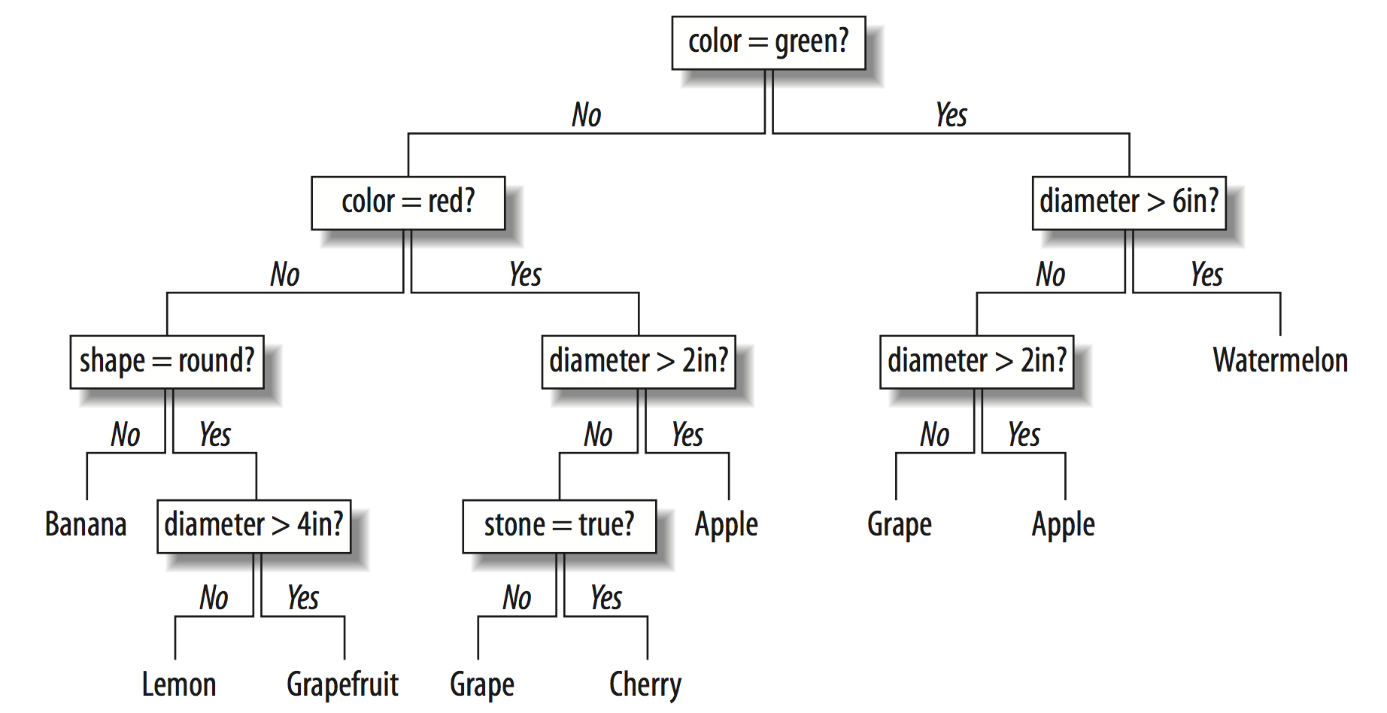
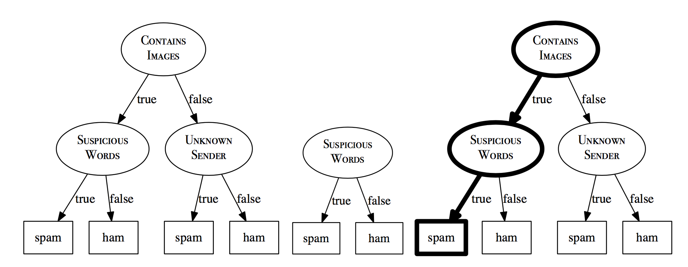
Algorithm
ID3 Algorithm (Iterative Dichotomizer 3) :: The ID3 algorithm builds the tree in a recursive, depth-first manner, beginning at the root node and working down to the leaf nodes.
Decision Tree/Rule Learning
A Decision Tree consists of:
A root node (or starting node),
Interior nodes
Leaf nodes (or terminating nodes).

Slide 19
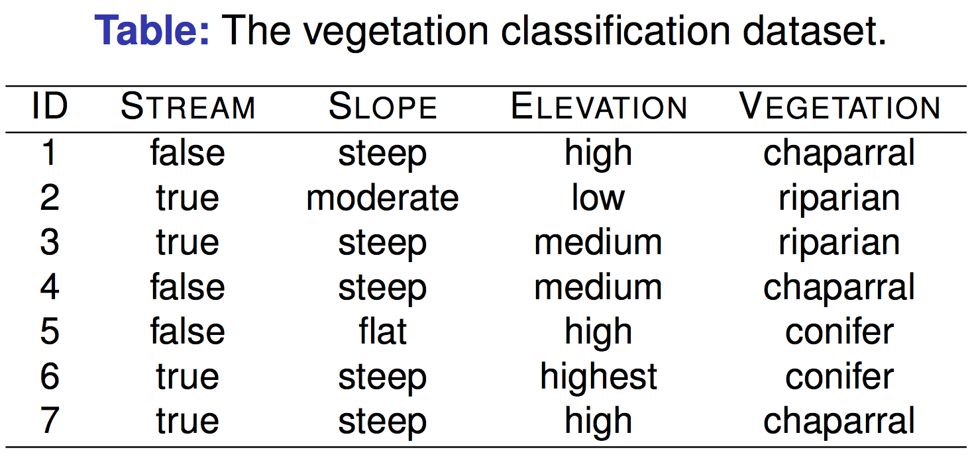
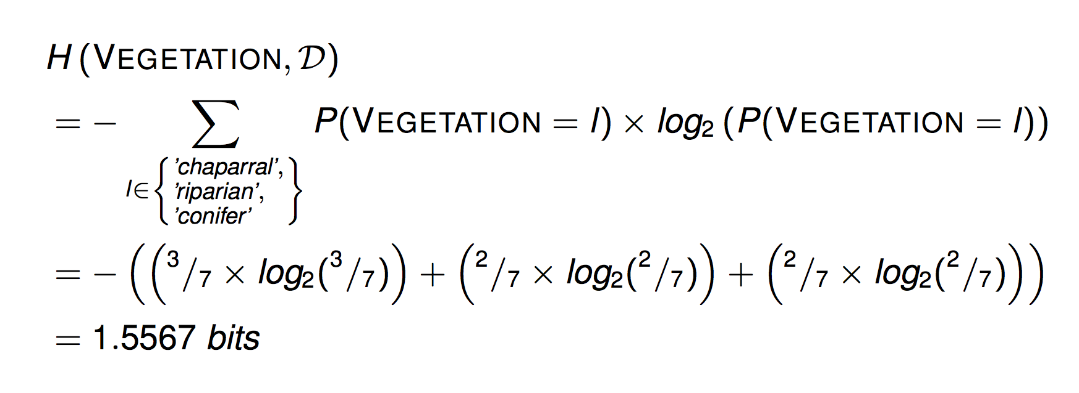

Slide 20
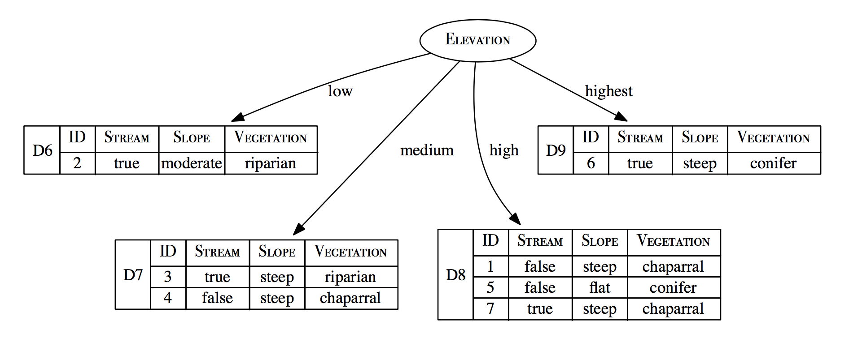
If we select “Elevation”, we have the following partition..
?
?
?
?

Slide 21
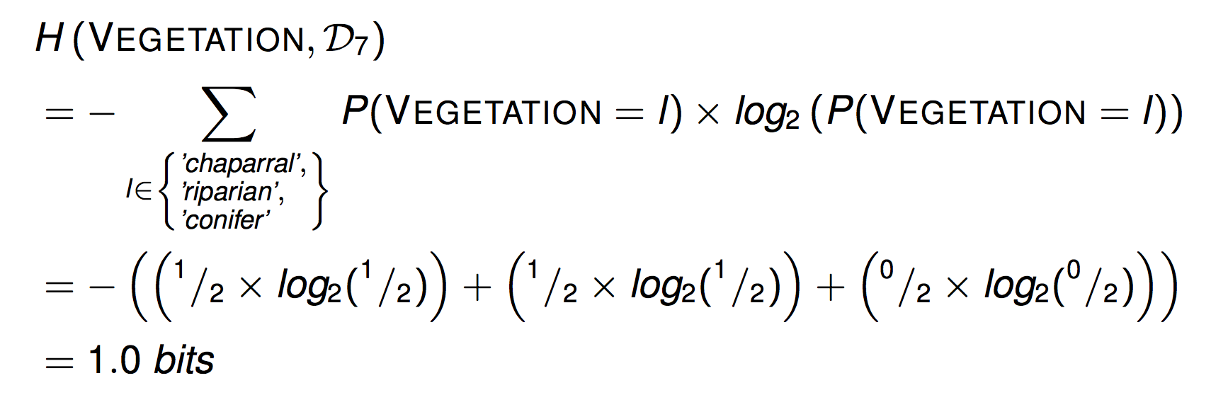

Slide 22
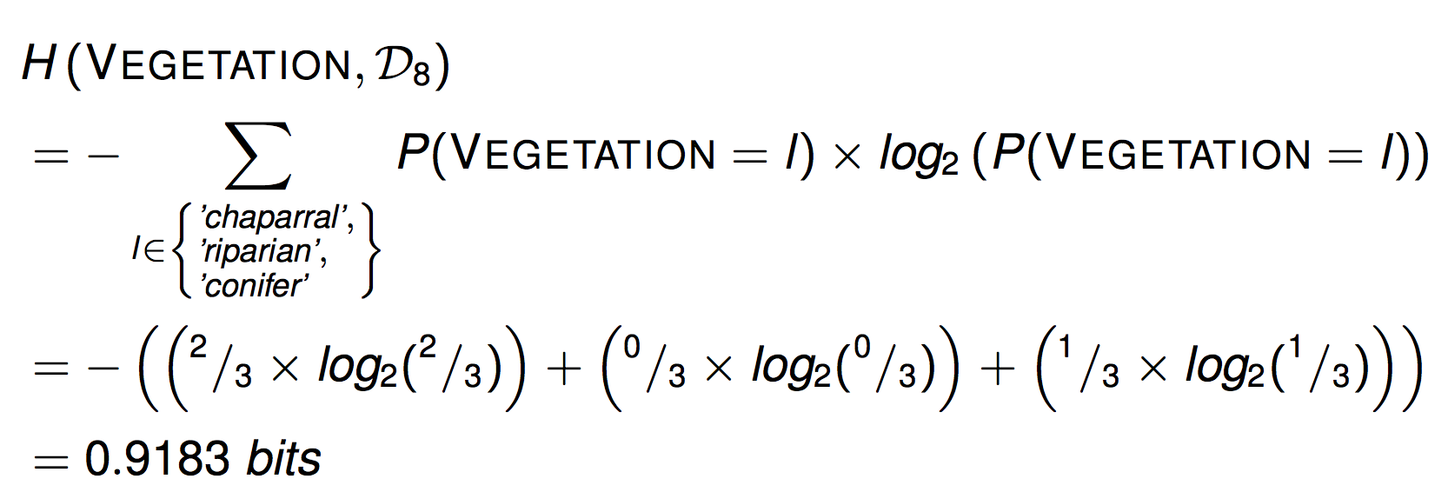

Slide 23
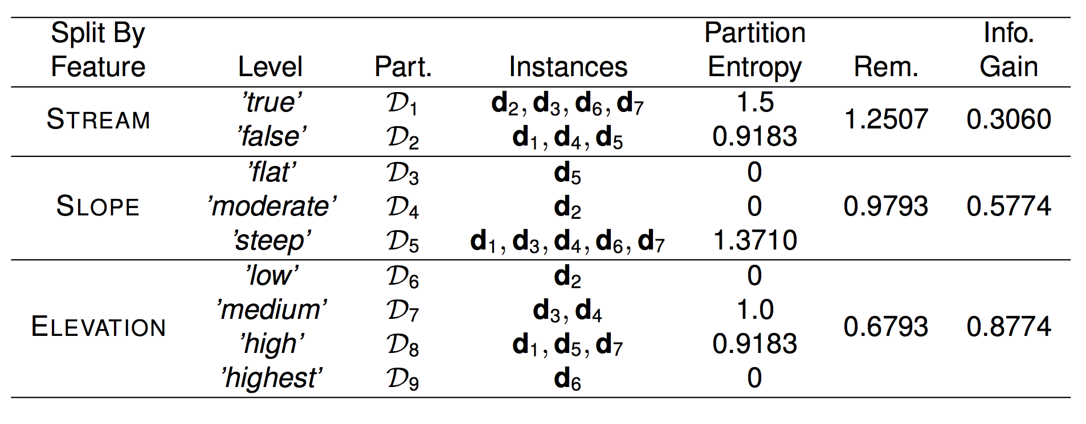
All Possible Selection on Features

Slide 24
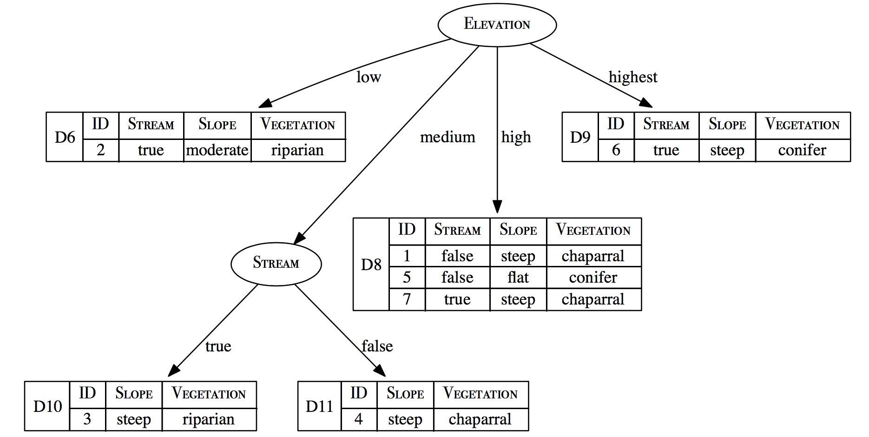
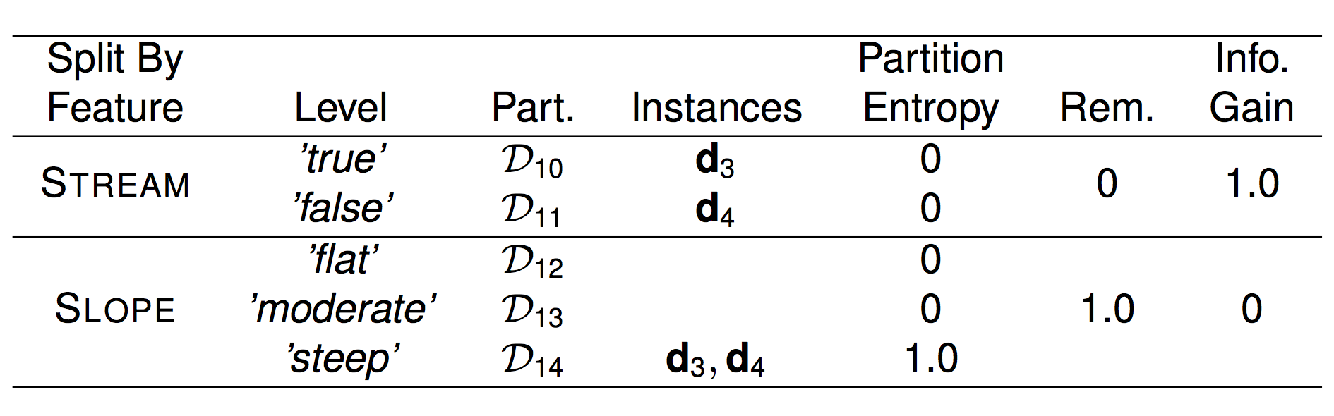

Slide 25
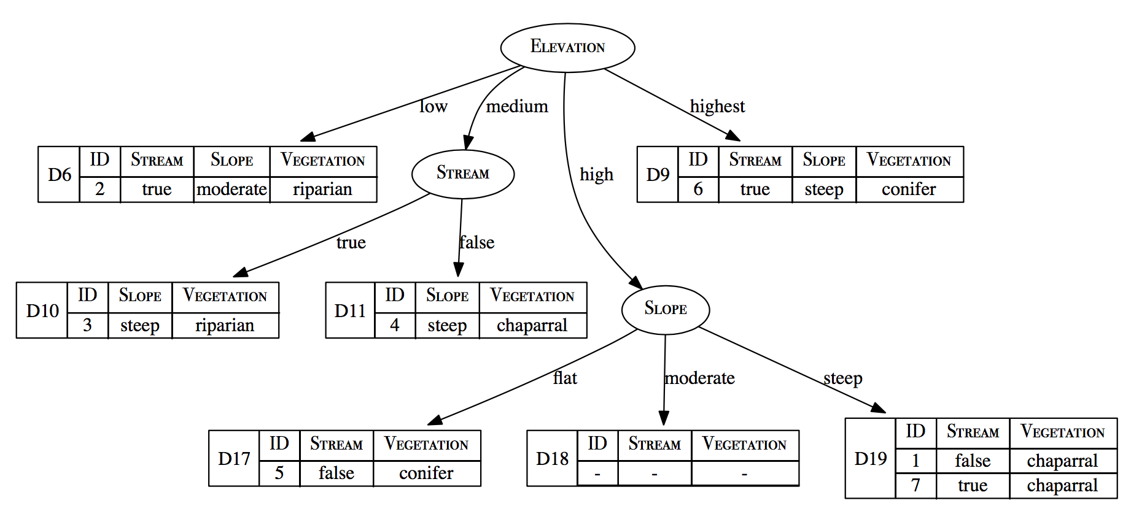

Slide 26
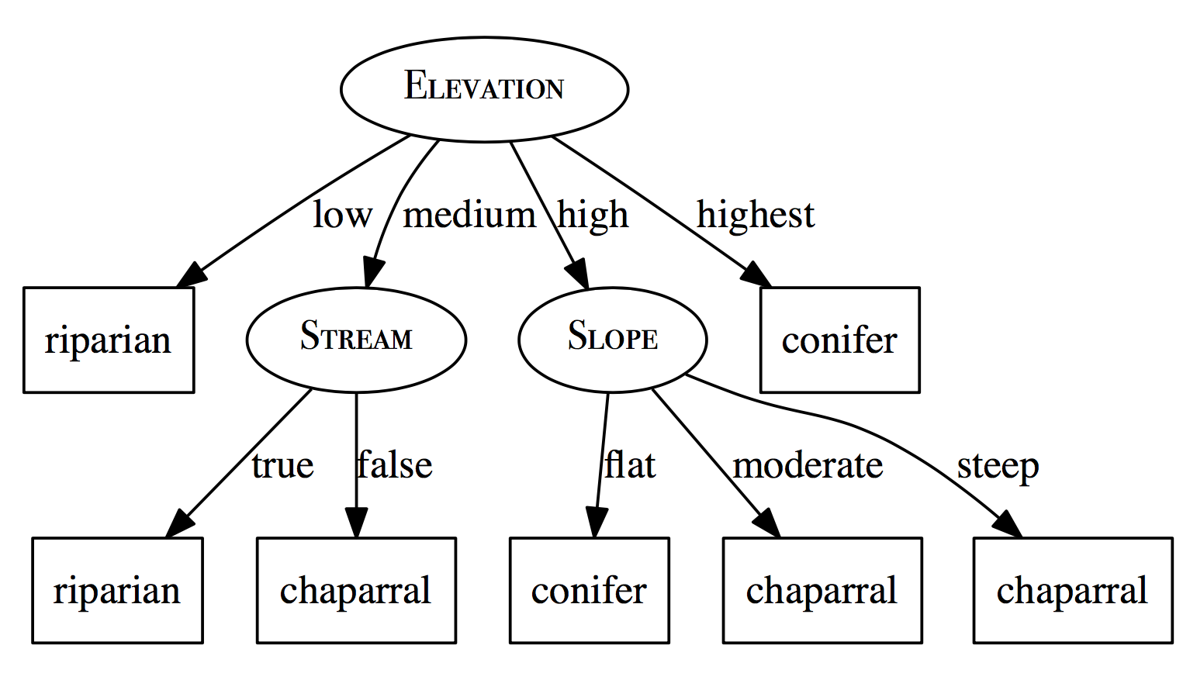
The Resultant Decision Tree

Slide 27
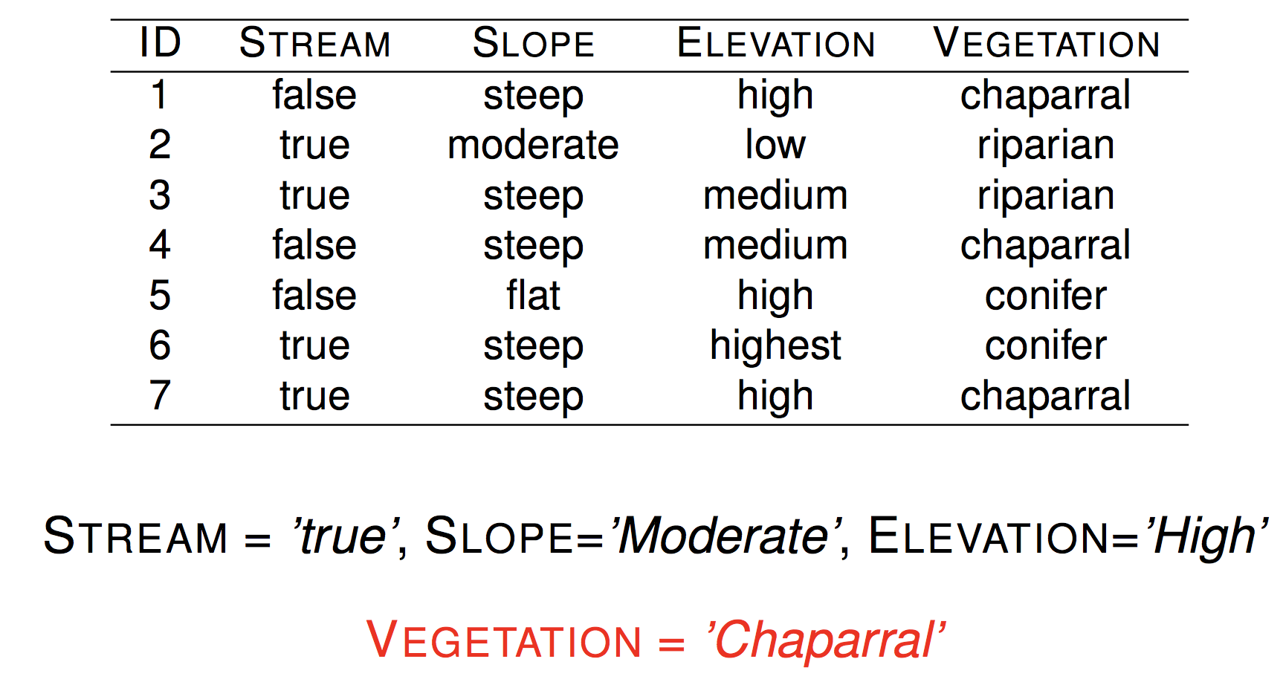
Important: There is a Rule Inferred

Slide 28
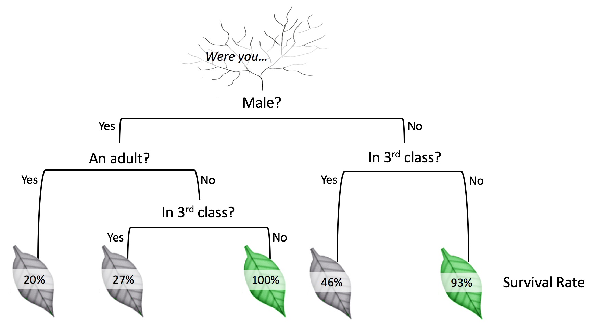
Decision Applications
空氣是否紫爆？
約會是否能成功？
銀行是否該貸款給你？
電信是否會續約？
是不是一個垃圾郵件？
你是否死於鐵達尼船難？
手寫辨識資料集？
…..

Slide 29
Advanced Issues

Slide 30
Advanced Issues
Impurity Measure
Handling Continuous Features
Predicting Continuous Targets
Ensemble Model
Bagging
Boosting

Slide 31
Impurity Measure
Entropy
Information Gain Ratio
Gini Index

Slide 32
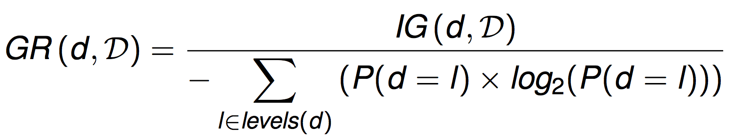
Information Gain Ratio
Entropy prefers features with many values.
One way of addressing this issue is to use information gain ratio which is computed by dividing the information gain of a feature by the amount of information used to determine the value of the feature

Slide 33
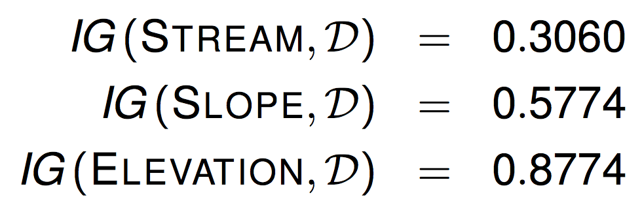

Slide 34
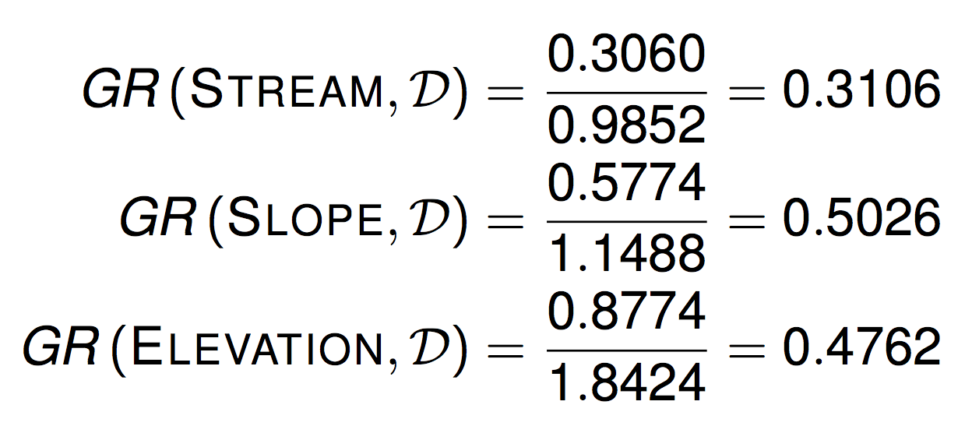
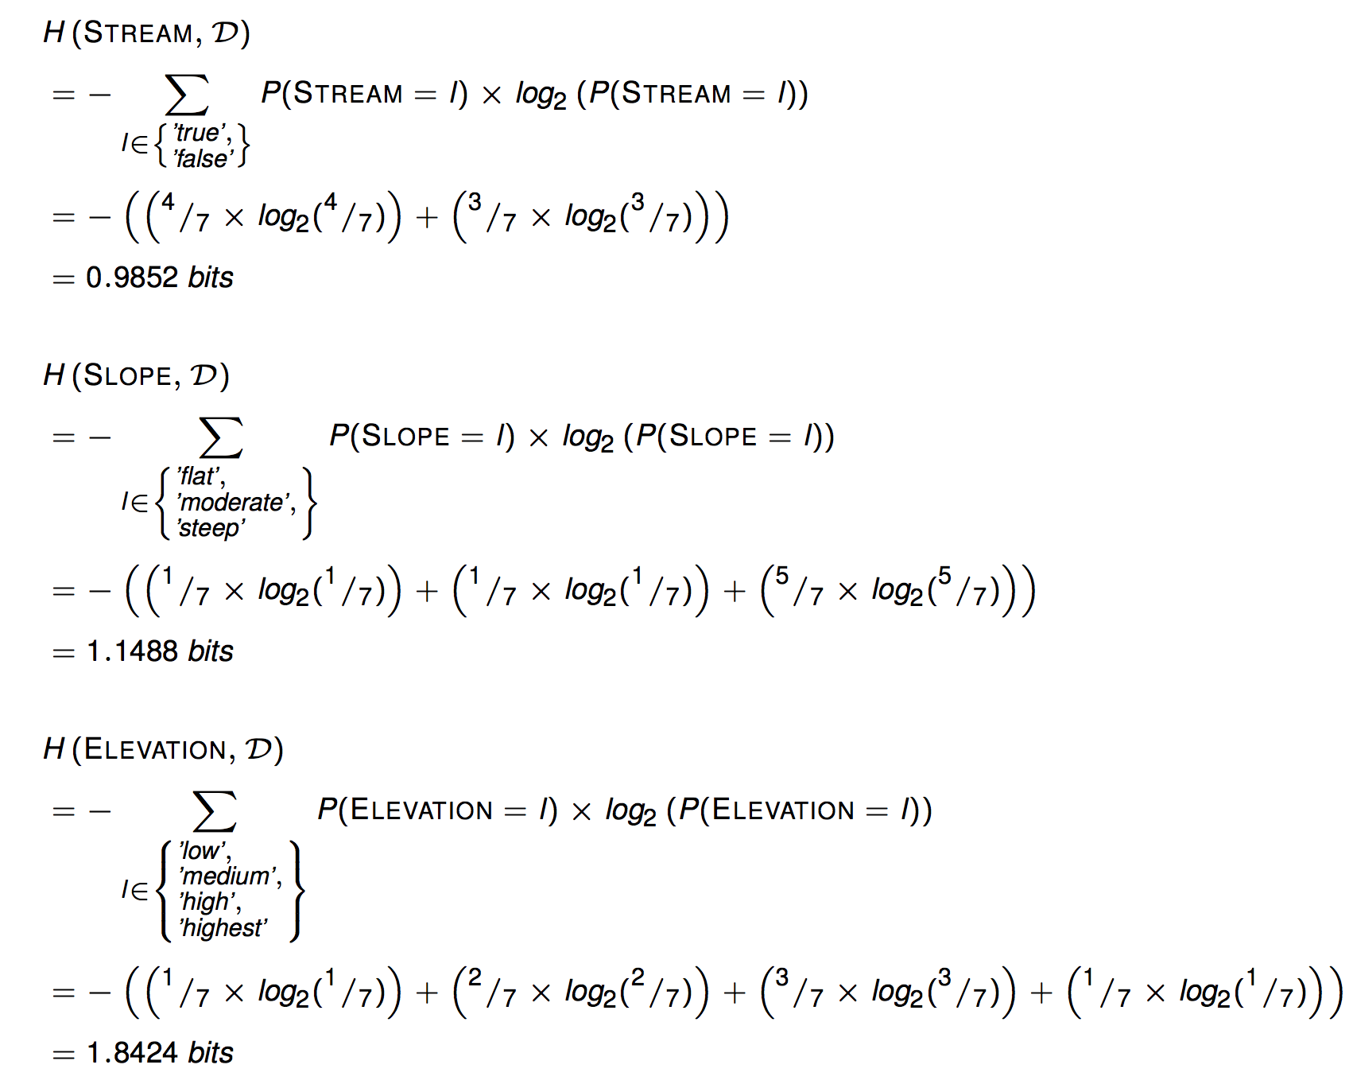

Slide 35
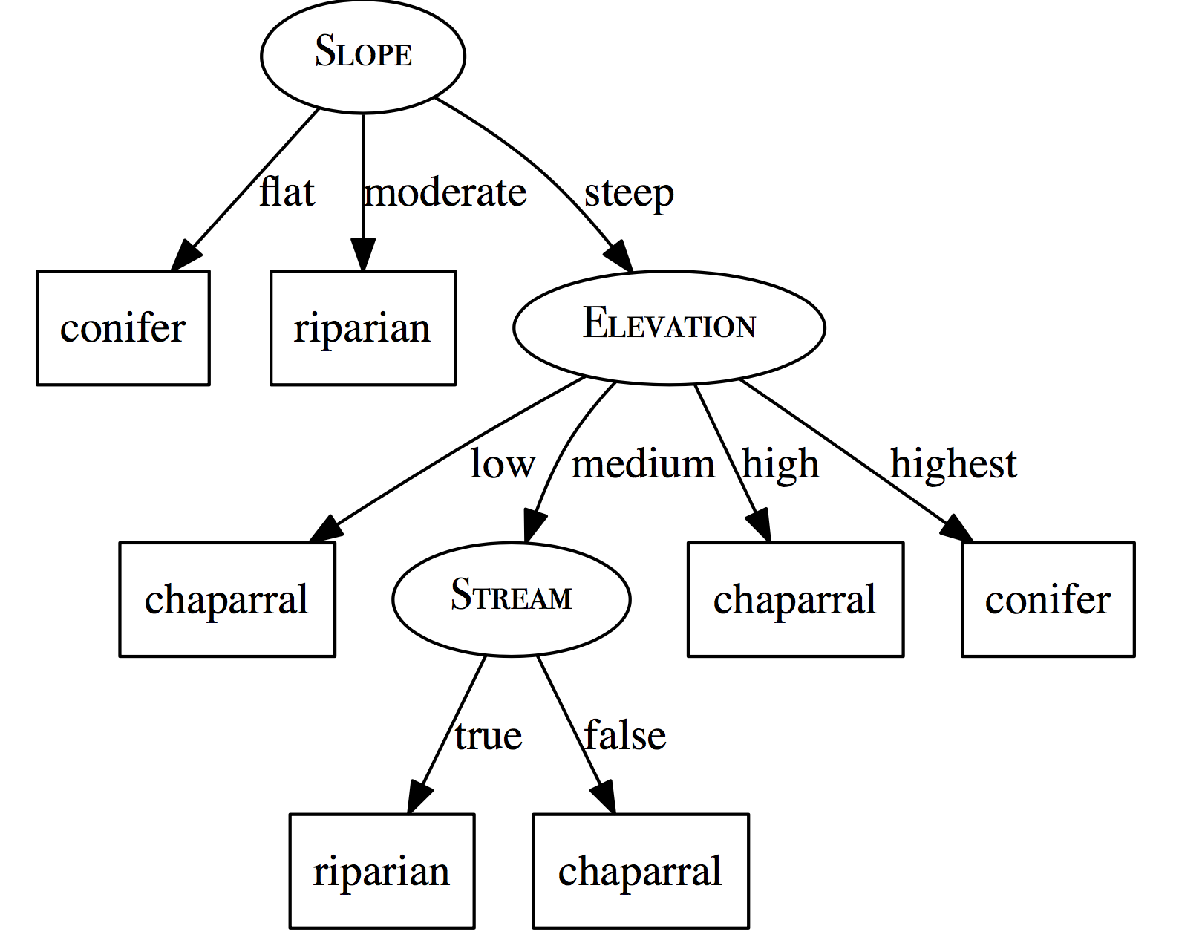
Entropy
Information Gain Ratio

Slide 36
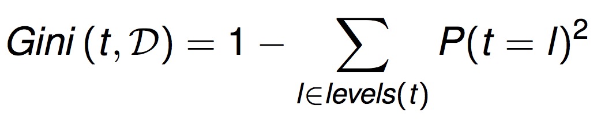
Gini Index
The Gini index can be thought of calculating how often you would misclassify an instance in the dataset if you predicted it based on the distribution of classifications in the dataset.
Information gain can be calculated using the Gini index by replacing the entropy measure with the Gini index

Slide 37
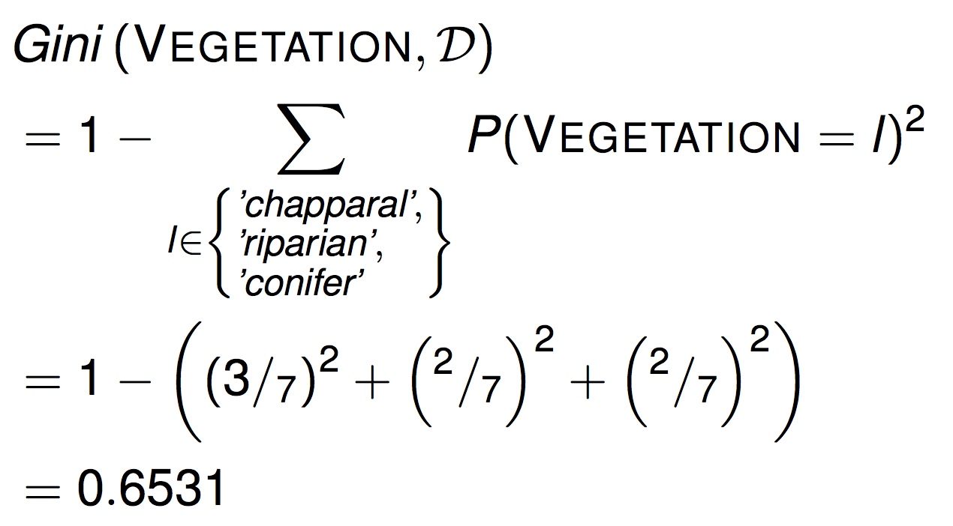

Slide 38
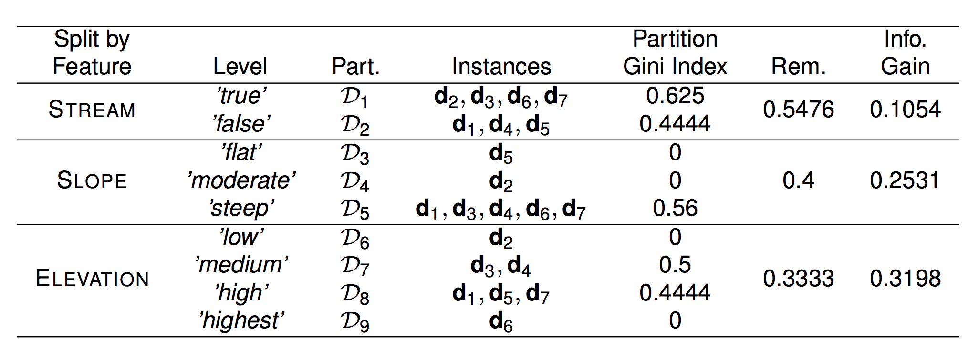
Gini index is more intuitive to be understood !!

Slide 39
Handling Continuous Features

Slide 40
Handling Continuous Features
The easiest way to handle continuous valued features is to turn them into boolean features by defining a threshold and using this threshold to partition the instances based their value of the continuous feature.
How do we set the threshold?
The instances in the dataset are sorted according to the continuous feature values.
The adjacent instances in the ordering that have different classifications are then selected as possible threshold points.
The optimal threshold is found by computing the information gain for each of these classification transition boundaries and selecting the boundary with the highest information gain as the threshold.

Slide 41
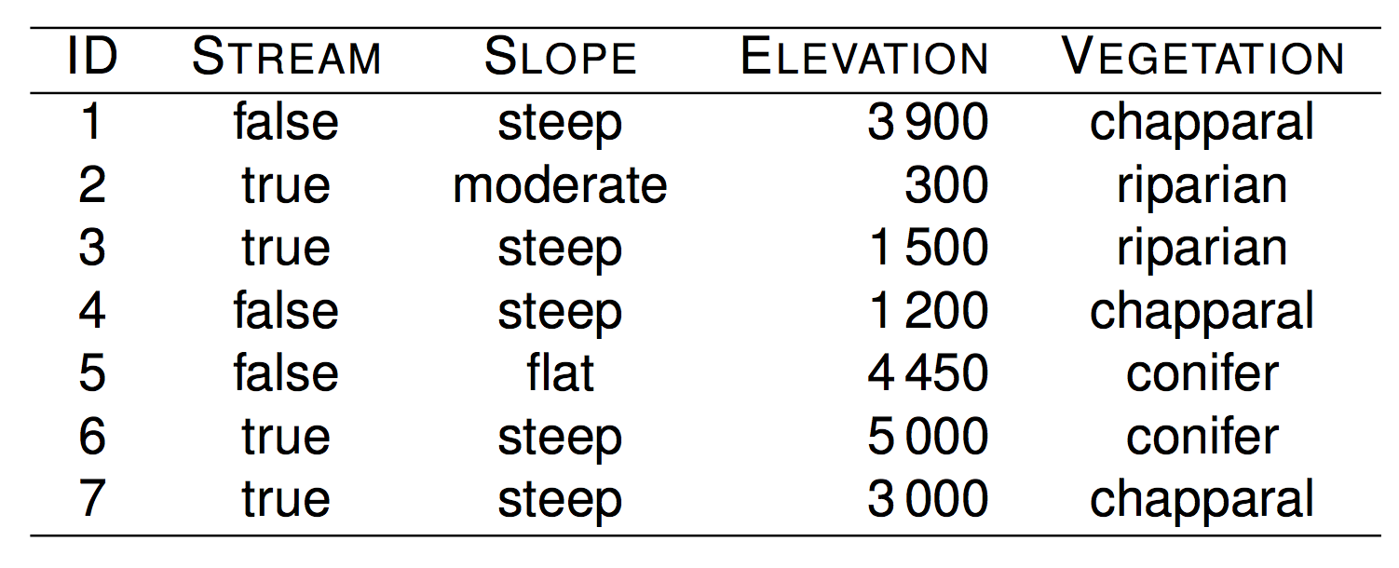
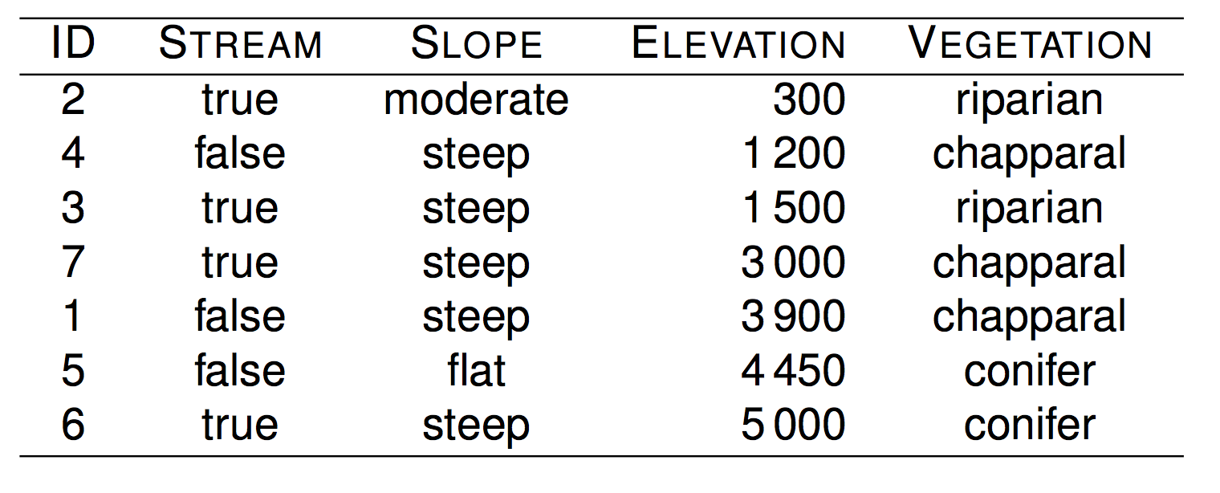
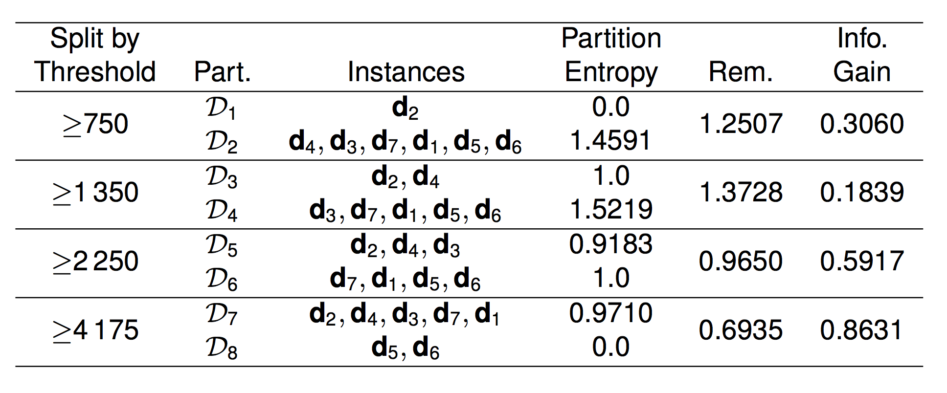

Slide 42
Once a threshold has been set, the dynamically created new boolean feature have to compete with the other categorical features for selection as the splitting feature at that node.

Slide 43
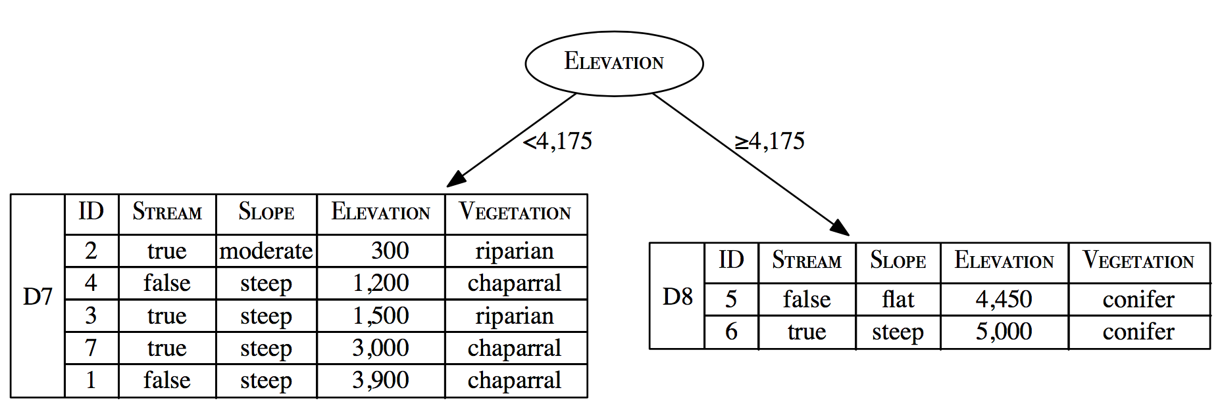

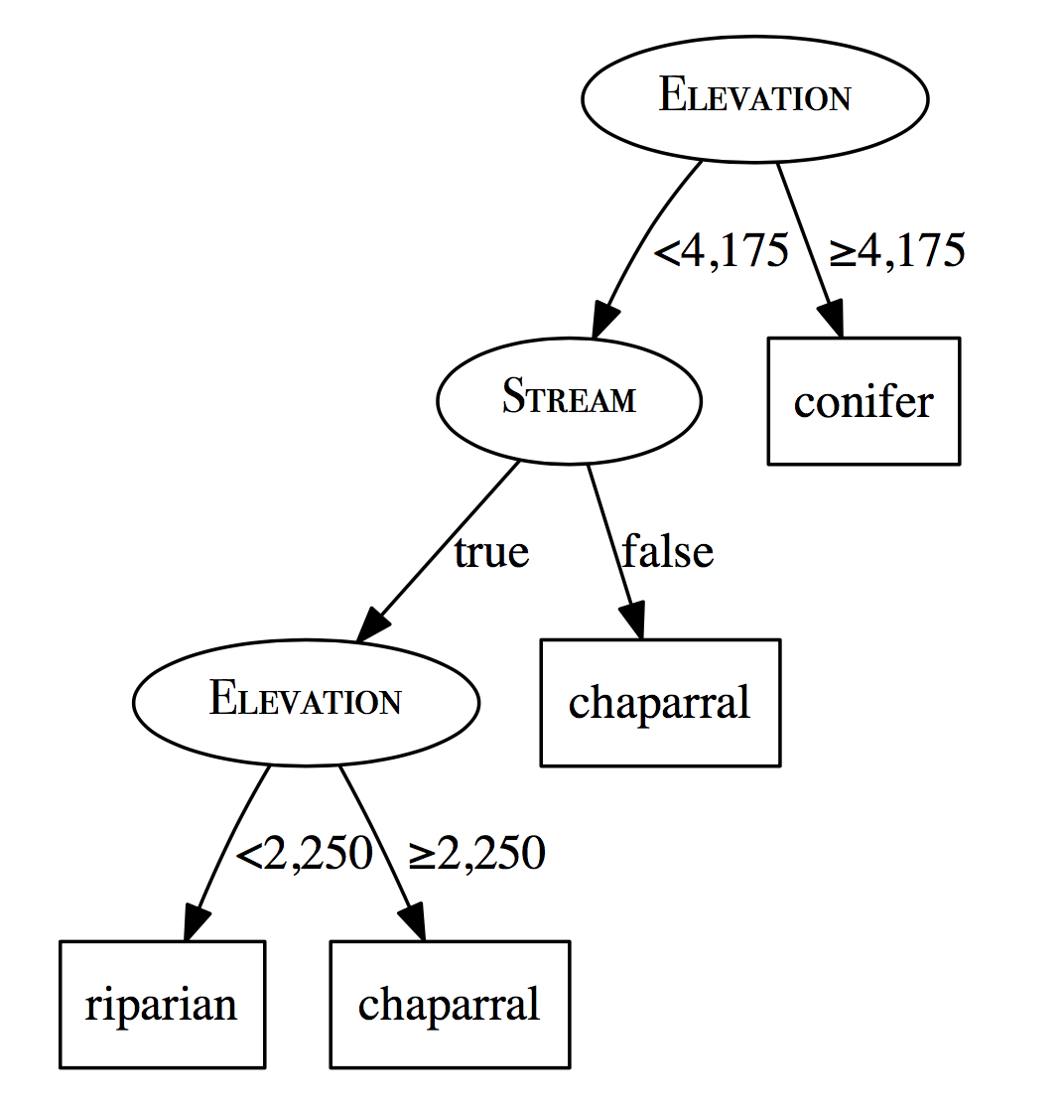
The vegetation classification decision tree after the dataset has been split using ELEVATION ≥ 4175.
?

Slide 44
Predicting Continuous Labels
Classification v.s. Regression

Slide 45
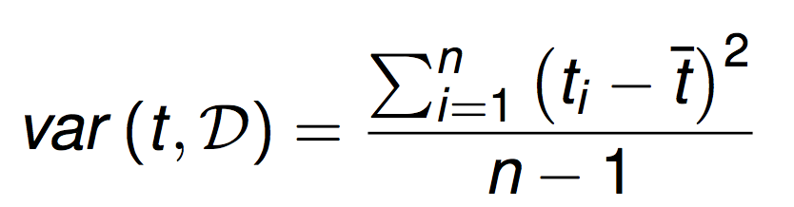
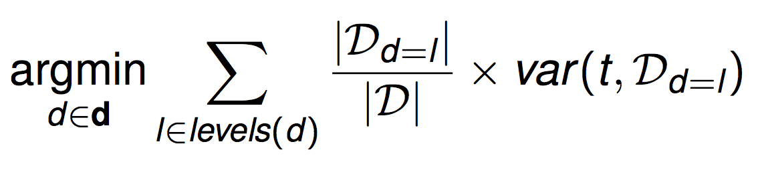
Predicting Continuous Targets
Regression trees are constructed so as to reduce the variance in the set of training examples at each of the leaf nodes in the tree
We can do this by adapting the ID3 algorithm to use a measure of variance rather than a measure of classification impurity (entropy) when selecting the best attribute
entropy—> variance

Slide 46
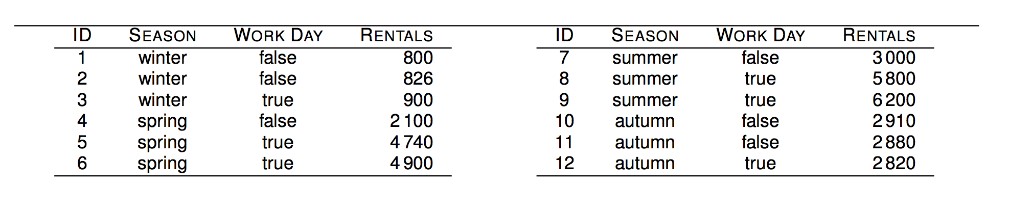

bike rentals per day

Slide 47



Slide 48
Summary
ID3 Algorithm
Handling both continuous and discrete attributes
Information Gain Ratio
J48 is an open source Java implementation of the C4.5 algorithm in the Weka data mining tool.
C4.5 Algorithm
Performance Improvement
CART Algorithm
C5.0 Algorithm
Gini Index
ID3, Quinlan, J. R. 1986. Induction of Decision Trees. Mach. Learn.
C4.5, Quinlan, J. R. C4.5: Programs for Machine Learning. Morgan Kaufmann Publishers, 1993.

Slide 49

Code Example:
https://github.com/UDICatNCHU/AdvancedDataMing/blob/master/DecisionTree.ipynb
https://colab.research.google.com/drive/1pQjI59byX1kTPd50g56jt26YdhP-2QJt

Slide 50

https://scikit-learn.org/stable/modules/generated/sklearn.tree.DecisionTreeClassifier.html#sklearn.tree.DecisionTreeClassifier

Slide 51


Slide 52


Notes:
from sklearn.datasets import load_iris
from sklearn import tree
iris = load_iris()
DT = tree.DecisionTreeClassifier()
DT = DT.fit(iris.data, iris.target)
from sklearn.model_selection import train_test_split
X_train, X_test, y_train, y_test = train_test_split(
iris.data, iris.target, test_size=0.33)

Slide 53
from pyspark.mllib.tree import DecisionTree, DecisionTreeModel
from pyspark.mllib.util import MLUtils
# Load and parse the data file into an RDD of LabeledPoint.
data = MLUtils.loadLibSVMFile(sc, 'data/mllib/sample_libsvm_data.txt')
# Split the data into training and test sets (30% held out for testing)
(trainingData, testData) = data.randomSplit([0.7, 0.3])
# Train a DecisionTree model.
# Empty categoricalFeaturesInfo indicates all features are continuous.
model = DecisionTree.trainClassifier(trainingData, numClasses=2, categoricalFeaturesInfo={},
impurity='gini', maxDepth=5)
# Evaluate model on test instances and compute test error
predictions = model.predict(testData.map(lambda x: x.features))
labelsAndPredictions = testData.map(lambda lp: lp.label).zip(predictions)
testErr = labelsAndPredictions.filter(lambda (v, p): v != p).count() / float(testData.count())
print('Test Error = ' + str(testErr))
print('Learned classification tree model:')
print(model.toDebugString())
https://spark.apache.org/docs/2.1.0/mllib-classification-regression.html

Slide 54
Ensemble Model

Slide 55
Bagging

Slide 56

Bagging (Bootstrap Aggregating)
Bootstrap Sampling
Each random sample is the same size as the dataset and sampling with replacement is used
Subspace Sampling
Only uses a randomly selected subset of the features in the dataset
The combination of bagging, subspace sampling, and decision trees is known as a random forest model.

Slide 57


Slide 58


Slide 59
Boosting # multiple trees # weighted voting # sequential adding tree

Slide 60
Boosting
Boosting works by iteratively creating models and adding them to the ensemble.
The iteration stops when a predefined number of models have been added.
When we use boosting each new model added to the ensemble is biased to pay more attention to instances that previous models miss-classified.
This is done by incrementally adapting the dataset used to train the models. To do this we use a weighted dataset

Slide 61
Boosting Idea Overview

Slide 62


Slide 63

Idea Overview
[0, 0.5]
Notes:
Total error is defined to be [0, 0.5]

Slide 64

Round1
D
0.1 | 0.2 | 0.3 | 0.4 | 0.5 | 0.6 | 0.7 | 0.8 | 0.9 | 1.0
1 | 1 | 1 | -1 | -1 | -1 | -1 | 1 | 1 | 1
α=1.738
Round2
True Label
0.1 | 0.1 | 0.2 | 0.2 | 0.2 | 0.2 | 0.3 | 0.3 | 0.5 | 0.8
1 | 1 | 1 | 1 | 1 | 1 | 1 | 1 | -1 | 1
D’
α=2.778
Round3
0.2 | 0.3 | 0.4 | 0.4 | 0.4 | 0.4 | 0.5 | 0.6 | 0.6 | 0.7
1 | 1 | -1 | -1 | -1 | -1 | -1 | -1 | -1 | -1
D’’
α=4.119
Sampling Probability
Round1 | x=0.1 | x=0.2 | x=0.3 | x=0.4 | x=0.5 | x=0.6 | x=0.7 | x=0.8 | x=0.9 | x=1.0
1 | 0.1 | 0.1 | 0.1 | 0.1 | 0.1 | 0.1 | 0.1 | 0.1 | 0.1 | 0.1
2 | 0.16 | 0.16 | 0.16 | 0.07 | 0.07 | 0.07 | 0.07 | 0.07 | 0.07 | 0.07
3 | 0.13 | 0.13 | 0.13 | 0.08 | 0.08 | 0.08 | 0.08 | 0.005 | 0.005 | 0.005

Slide 65

Round1 | x=0.1 | x=0.2 | x=0.3 | x=0.4 | x=0.5 | x=0.6 | x=0.7 | x=0.8 | x=0.9 | x=1.0
1 | -1 | -1 | -1 | -1 | -1 | -1 | -1 | 1 | 1 | 1
2 | 1 | 1 | 1 | 1 | 1 | 1 | 1 | 1 | 1 | 1
3 | 1 | 1 | 1 | -1 | -1 | -1 | -1 | -1 | -1 | -1
sum | 5.1 | 5.1 | 5.1 | -3.08 | -3.08 | -3.08 | -3.08 | 0.39 | 0.39 | 0.39
Sign | 1 | 1 | 1 | -1 | -1 | -1 | -1 | 1 | 1 | 1
α=1.738
α=2.778
α=4.119

Slide 66

Why we need multiple trees ?
Rule-based Learning / Information-based Learning
Decision-Tree
Error-based Learning / Loss-based Learning
Neural Network (Logistic Regression)
Probability-based Learning
Naïve Bayes Network (NB)
Similarity-based Learning
K-Nearest Neighbor (K-NN)
How to fit this curve ?

Slide 67




Different Viewpoint to the Same Problem

Slide 68


Why multiple tree help to boost the performance?

Slide 69
AdaBoost : Adaptive Boosting Algorithm # boosting # weak classifier # tree stump # regularization

Slide 70



Adaboost (Adaptive Boosting)

Slide 71

Adaboost

Slide 72
Adaboost (Adaptive Boosting)

Slide 73



Adaboost (Adaptive Boosting):
Full Tree
Stump

Slide 74




Adaboost Overview

Slide 75




Gini Index = 0.47
Gini Index = 0.5
Gini Index = 0.2

Slide 76


Total Error:
the sum of the weights of misclassified samples

Slide 77



Total error = 1/8
=0.97
Weight = 0.97

Slide 78





Slide 79





New stump
Resample according to new weight

Slide 80



Iteratively Create a forest of stumps

Slide 81


How to make decision/prediction ?

Slide 82
Adaboost Review

Slide 83

Adaboost Review

Slide 84
Adaboost

Slide 85
Underfitting Issues
-
-
-
-
+
-
-
+
+
-
-
+
+
-
-
+
+
+
-
-
+
+
+
-
-
+
+
+
+
+
-
-
-
-
+
-
-
+
+
+
+
+
-
-
-
-
-
-
+
+
+
+
-
+
-
-
+
+
+
-
-
-
+
+
-
-
+
+
-
+
-
-
-
+
+
-
-
+
-
+
-
-
+
-
+
+
+
+

Slide 86
Underfitting Issues

Slide 87
Another Viewpoint: Gradient Boosting
Gradient Boosting trains many models in a gradual, additive and sequential manner.
The major difference between AdaBoost and Gradient Boosting Algorithm is how the two algorithms identify the shortcomings of weak learners (e.g., decision trees).
While the AdaBoost model identifies the shortcomings by using high weight data points, gradient boosting performs the same by using gradients in the loss function

Slide 88

Gradient Boosting Tree

Slide 89


Step1: Compute average over all target values

Slide 90




Step 2: Compute error for all target values based on the prediction in Step 1
Step 3: Build a regression tree to predict the error/residual

Slide 91




Step 4: Making prediction based on previous trees’ prediction
Step 5: Compute error for all target values based on the new prediction
Step5: Build a regression tree to predict the new error/residual

Slide 92






Step 6: Making prediction based on previous trees’ prediction
+
+
Step 7: Repeat Step2-Step6 until terminated

Slide 93
Gradient Boosting Tree

Slide 94

Why call Gradient Boosting ?
Why Not Residual Boosting ?

Slide 95


????

Slide 96


GBT idea overview

Slide 97

GBT idea overview

Slide 98


